Slide 1
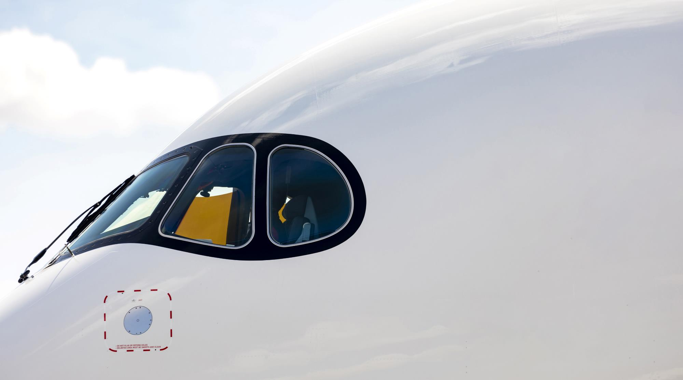

CORPORATE
PRESENTATION
2026

Slide 2








Our purpose ALIGNs Business Strategy with Sustainable Customer Expectations for a Better Tomorrow
“At the forefront of a more responsible European aviation,
we unite people for the world of tomorrow”

Slide 3
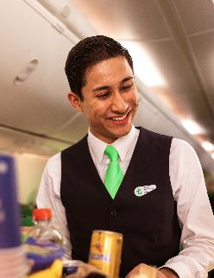
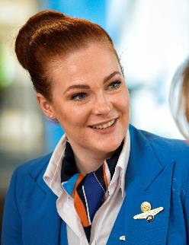
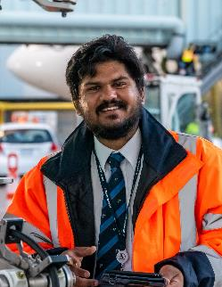
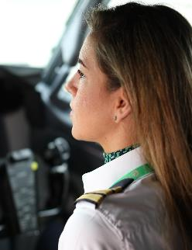
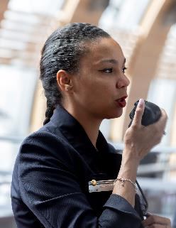
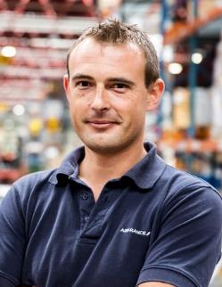

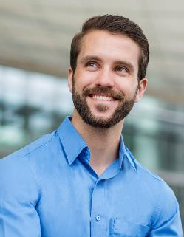
Our people build our future and our success
We are thankful for the commitment of all our staff and for the trust of our customers and shareholders.
They are an integral part of our success.

Slide 4
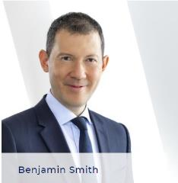
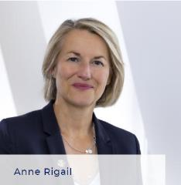
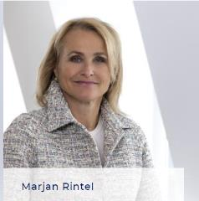
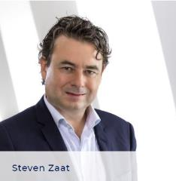
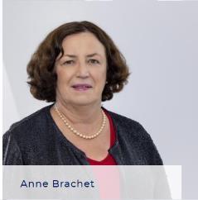
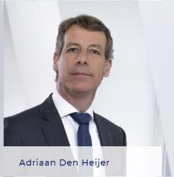
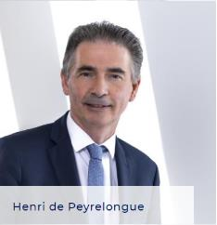
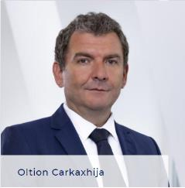
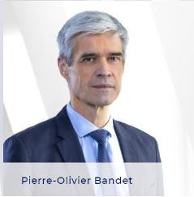
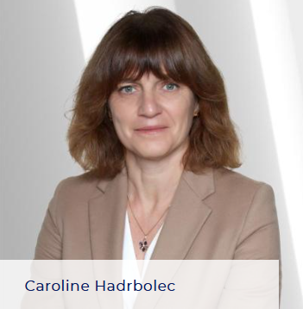
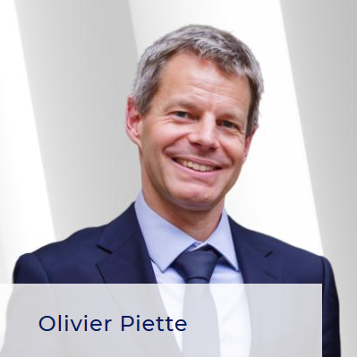
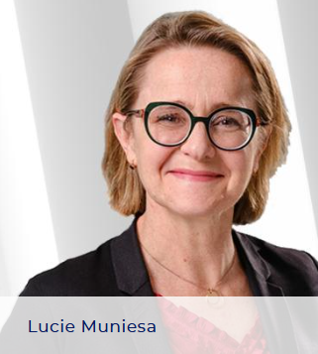
GOVERNANCE
EXECUTIVE COMMITTEE
Chaired by the Chief Executive Officer of Air France-KLM, the Group Executive Committee is composed of the Chief Executive Officer of Air France-KLM, the President and Chief Executive Officer of KLM, the Chief Executive Officer of Air France and the 8 heads of the Group's functions.
The Executive Committee is responsible for making key strategic decisions, overseeing organizational performance while ensure effective implementation of the company’s goals.
Chief Executive Officer, Air France-KLM
Chief Executive Officer, Air France
President & Chief Executive Officer, KLM
Chief Financial Officer, Air France-KLM
EVP Engineering & Maintenance, Air France-KLM
EVP Chief Commercial Officer, Air France-KLM
EVP SAS Integration, Air France-KLM
EVP Chief Operating Officer, Air France-KLM
EVP Cargo, Air France-KLM
EVP Human Resources, Air France-KLM
EVP Strategy & CEO Office, Air France-KLM
Executive Vice President, Corporate Secretary, Air France-KLM
Notes:
Section gouvernance en 2 slides – Board en 1 et COMEX en 2
Board section : rajouter plus d’éléments sur leurs responsabilités et rôles + inclure le visuel dispo sur le site AFKL Groupe –

Slide 5





Our renewed STRATEGIC AMBITION
Our foundations
Our strategic roadmap
STRONG ASSETS
TO LEVERAGE
RESTORED BALANCE SHEET POST-COVID
GROUP-WIDE TRANSFORMATION ALREADY WELL UNDERWAY
Improve market position and strengthen business models
+
Boost profitability to join Europe’s frontrunners
Maximise customer satisfaction and enhance brand value
+
Increase employee engagement and satisfaction
Lead the way in sustainable aviation
Leverage technology, innovation and data

Slide 6

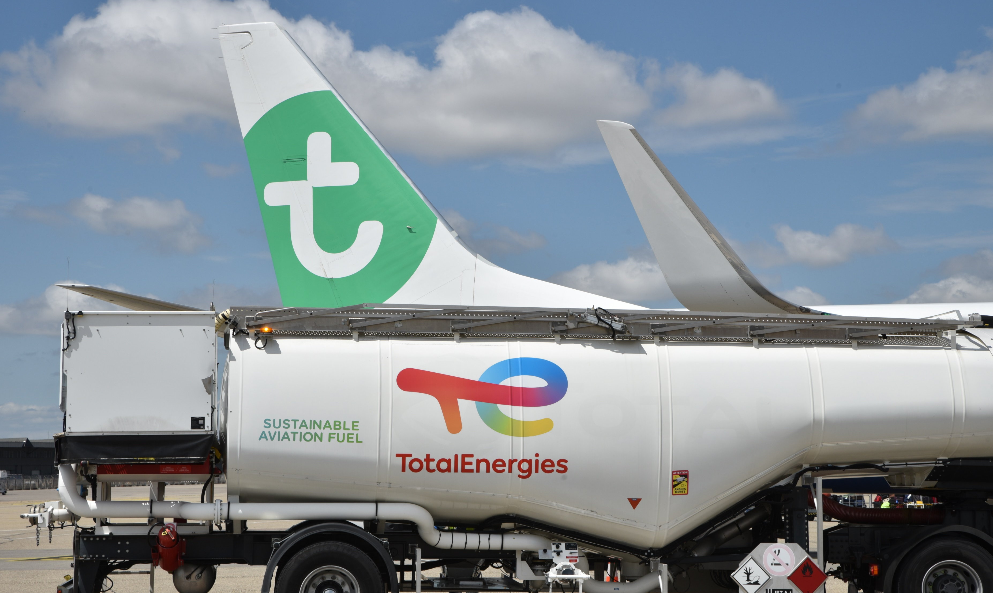
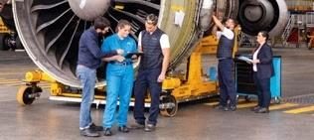
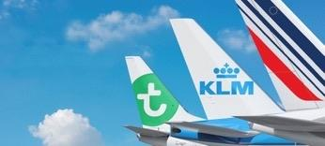


Our strengths support our businesses and enable us to deliver on air France-KLM strategy
80,000
Passionate and
Professional People
Three
Powerful Brands
Powerful
Partnerships
Networks
Extensive and
Complementary
Sustainable
Initiatives and Commitments

Slide 7







Key figures IN 2025
2 hubs
103 million passengers transported
586 aircraft
in operation
€489m Net Result
3 main activities
Passenger transport
Cargo
Aircraft Maintenance
30+ million
Flying Blue
loyalty program members
320+ destinations
In 100+ countries

Slide 8





A COMPREHENSIVE PORTFOLIO OF THREE RECOGNIZED BRANDS, WITH UNIQUE IDENTITIES AND POSITIONING
UNIQUE BRAND PORTFOLIO
LONG-HAUL
Paris Global Gateway
Amsterdam as Global Hub
SHORT & MEDIUM-HAUL
Connection to Paris and hub feeding
Hub feeding and corporate point-to-point traffic
Hybrid leisure and corporate low-cost
Price sensitive leisure
Price sensitive
corporate
Premium
leisure
Premium
corporate
Luxury
Economy
Economy
World Business Class
World Business Class
max
Premium Comfort
Premium Comfort

Slide 9
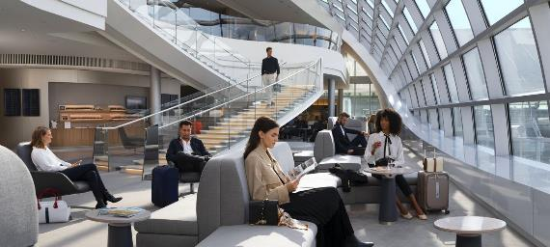
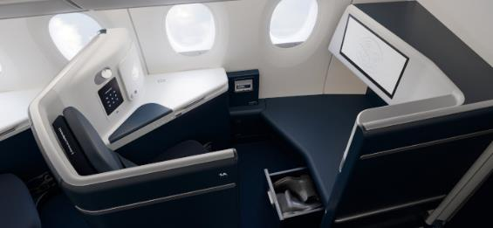
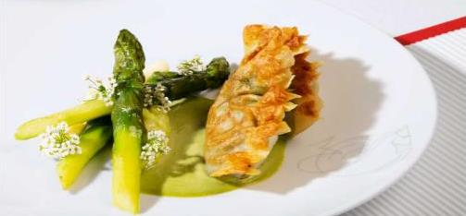






keeps upgrading its products
Along the journey experience
Cabin experience
Onboard services
Lounge upgrades
New First-class cabins in 2025
High-speed Wi-Fi
Catering
Comfort
Design
New Business class cabins
In-flight entertainment system
Partner services
Luggage door-to-door
Concierge
New Premium class cabins
Extend French excellence catering
Notes:
Precise in voiceover what catering options are we highlighting

Slide 10

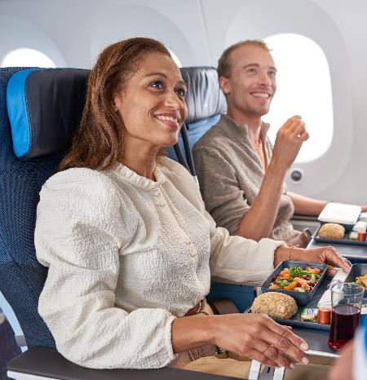

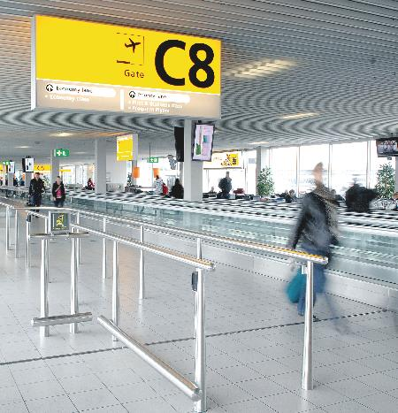
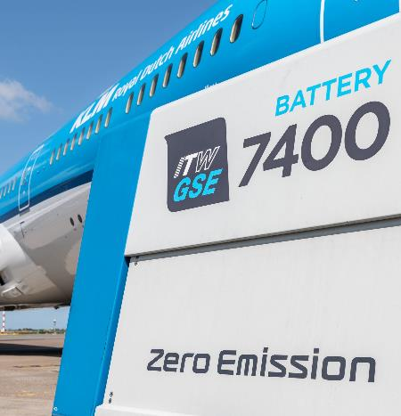
FULL FOCUS ON FURTHER ENHANCING CUSTOMER EXPERIENCE
Invest in
products and services
Recover
operational stability
Further strengthen Schiphol Hub
Invest for the future
Notes:
BC: Cabin upgrade will improve customer satisfaction
PCC: Strong customer appreciation since launch in 2022
EC: Reducing service failures and recovery to improve score

Slide 11
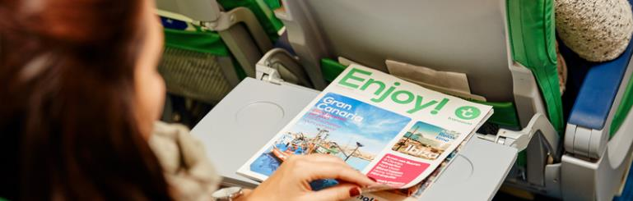

IS EXPANDING its OFFER AND continues to grow
Leisure
Corporate
Strengthen leadership on Mediterranean destinations, develop winter network
Transavia Holidays, to increase leisure wallet share
Develop other ancillaries (baggage, seat, etc.)
Address corporate demand from Paris-Orly
Flying Blue earning and burning
MAX fare, dedicated product to Business travelers
Development of a high contribution corporate business will lead to a twin-engine revenue model
Notes:
Add to the voiceover explanation on why the fleet improves OPS

Slide 12
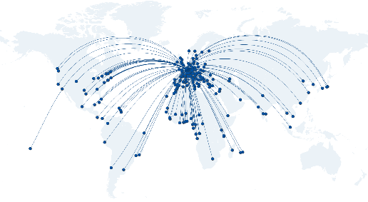
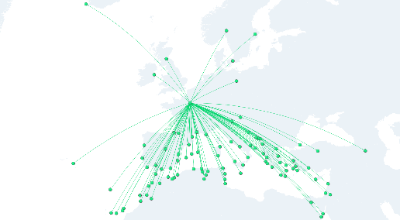
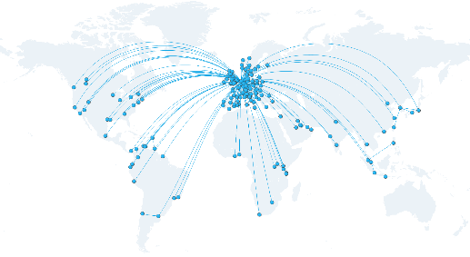
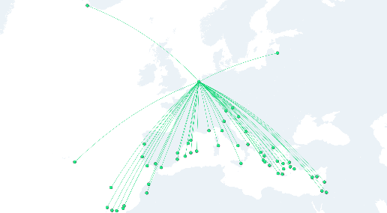
TOGETHER, AIR FRANCE, KLM and Transavia OFFER TRAVELLERS ONE OF THE WORLD'S MOST EXTENSIVE and diversified NETWORKS
from CDG
from ORY
170
Air France destinations from CDG
160
KLM destinations from AMS
from AMS
from AMS
140
Transavia destinations from ORY and AMS

Slide 13

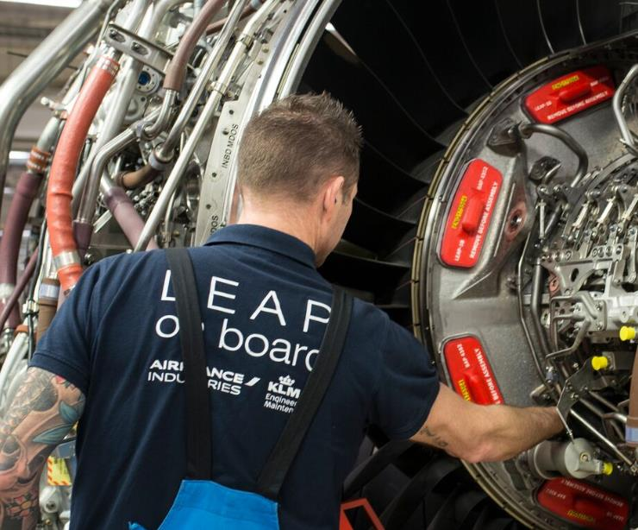
AS a profitable world-leading multi-product MRO provider, Air France-KLM E&M is a key asset for the group
in 2025
3,000
aircraft supported
13,000+
employees
200+
customer airlines
€9.36bn
order book (31/12/25)
€5.5bn
total revenues
€2.3bn
external revenues

Slide 14
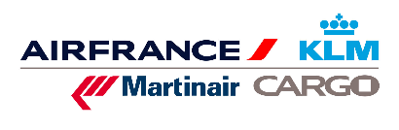
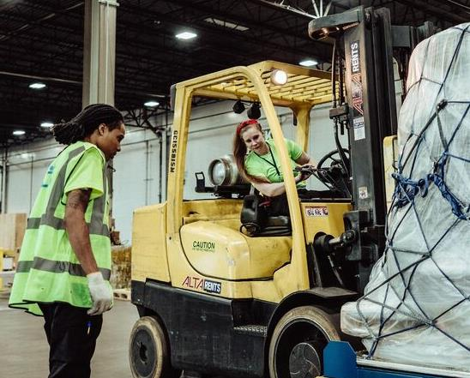
AIR FRANCE-klm Cargo remains a strong player in a rapidly changing market
in 2025
€2.3bn
traffic revenues
917,000
freight tons
Almost 91% of initial
bookings online
3,200 employees

Slide 15







Flying Blue is a leading European loyalty program
The loyalty program of the group’s airlines…
… Featuring more than 40 airline partners…
including
… and an extensive network of non-airline partners
European loyalty program with highest number of co-branded card partners with 13 co-branded cards (“CBC”)
100+ commercial partners spread over the world

Slide 16

Air France-KLM continues its transformation efforts
Actioning key levers…
…through ambitious roadmap…
…to achieve structural benefits¹
Simplification
700+
€4.4bn
Initiatives & Projects
Synergies
€3.0bn
€2.1bn
Across
Revenues initiatives
ALL
Business Units
Cost Savings
1) Structural benefits includes revenue initiatives and all operating cost efficiency gains, excluding CPI & CLA effects. Adjusted for capacity evolutions

Slide 17

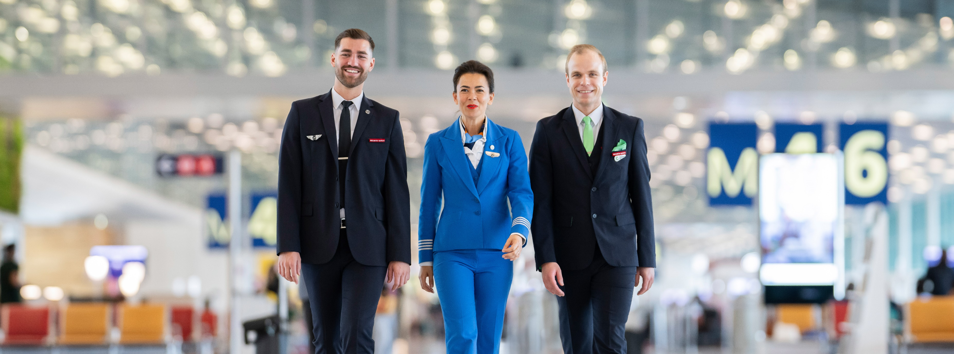

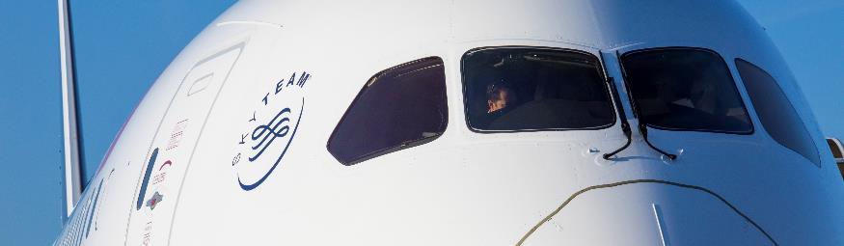
We have embarked on A successful trajectory towards a more sustainable growth
Optimized the basics
A simplified & optimized operating model
Stabilized social relations
Our key values: Trust, Respect, Transparency, Confidentiality
Sustainability
Achievements & commitments
Ongoing transformation
A successful delivery, including significant cost savings

Slide 18






Major levers to reach air France-KLM’s emission reduction targets by 2030
2030
Intermodality
Fleet renewal
Sustainable Aviation Fuel
Operational measures
-17,8%
CO2 / RTK (vs ‘24)

Slide 19
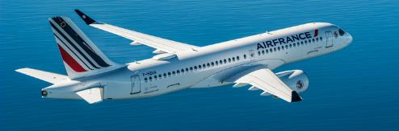
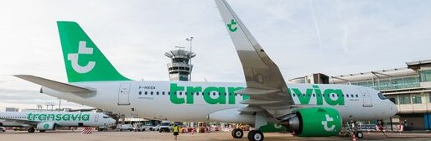
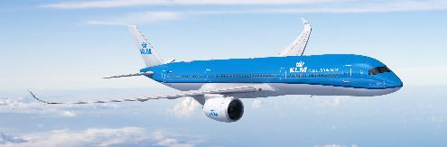


OUR FLEET RENEWAL STRATEGY DELIVERS STRONG CONTRIBUTION
TO OUR ENVIRONMENTAL ROADMAP
A220 family firm orders for:
A320neo family firm orders for:
A350 family firm orders for:
CO₂ emissions¹
-20%
-15%
-25%
NOX emissions¹
between -30% and -40%
Noise¹
between -34% and -50%
% of new generation aircraft
5%
21%
34.6%
Up to
80%
2019
2023
2025
2030
On average, compared to previous generation aircraft they replace
Notes:
Fleet strategy is a key component of our Group’s financial and environmental roadmap:
Finance: Lower consumption and younger fleet improves profitability by reducing fuel and MRO costs
Environment: Substantial CO2 and noise emissions reduction with new generation fleet
Fleet renewal is in line with our network strategy:
A220: Air France medium-haul flexibility and hub feeding role

Slide 20

AIR FRANCE-KLM IS fully committed TO SAF, with the ambition of incorporating 10% of SAF by 2030

Slide 21












Air France-KLM sourcing initiatives to reach 2030 SAF target keeping flexibility in volumes to match our demand
Air France KLM possible offtakes – Key SAF Projects start-up date
Air France – KLM
sourcing strategy
0.3 Mton Biofuel, MoU up to 2030
Grandpuits starts
1.5 Mton Biofuel, MoU for 10 years offtake
“Take Kair” e-fuel project
in France
Our strategy relies on materializing the contracts based on best:
SAF player in USA
0.3 Mton Biofuel, MoU
up to 2030
Energy player
in Americas
0.580 Mton Advanced biofuel, MoU for 10 years offtakes
Price
2023 | 2024 | 2025 | 2026 | 2027 | 2028 | 2029 | 2030
Oil Major in EU
0.65 Mton Biofuel,
MoU up to 2030
Availability
1 Mton Biofuel, 8 years offtake agreement
DSL01 starts
0.75 Mtons Biofuel 10 years offtake
“KerEAUzen” e-fuel project in France
Quality
Energy Player in EU
0.45 Mton Advanced biofuel,
MoU up to 2030
1st Plant starts
0.6 Mtons Advanced biofuel 10 years offtake

Slide 22
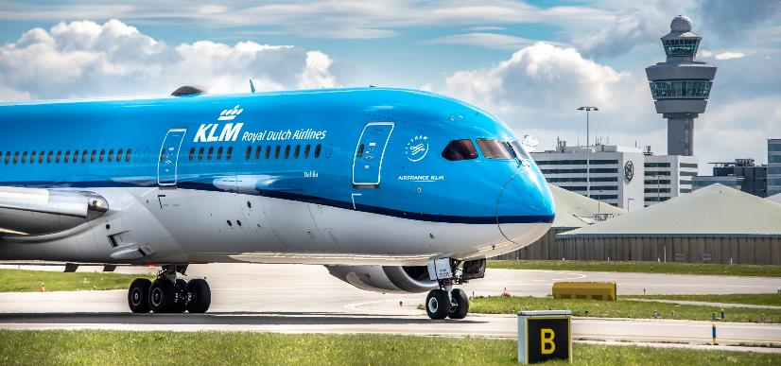
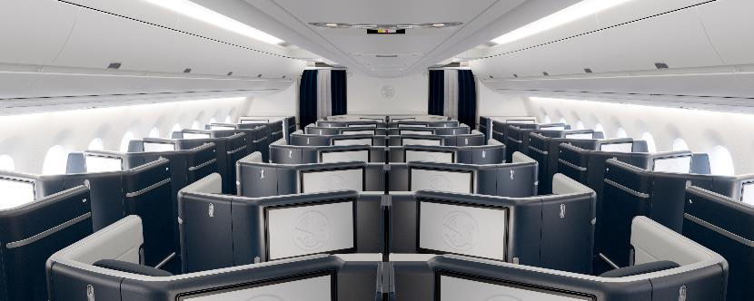
Greater efficiency in our operations and additional commercial measures can be leveraged to support our decarbonization trajectory
Main levers currently identified
OPERATIONAL
Eco-piloting & speed flying Aircraft performance improvement (maintenance, engine wash, aircraft washing, reduce APU usage…) Weight reduction (OEM suppliers, catering quantities, type of seat...)
COMMERCIAL
Load factor (potential network impact) Cabin layout optimization Product on board (IFE)

Slide 23

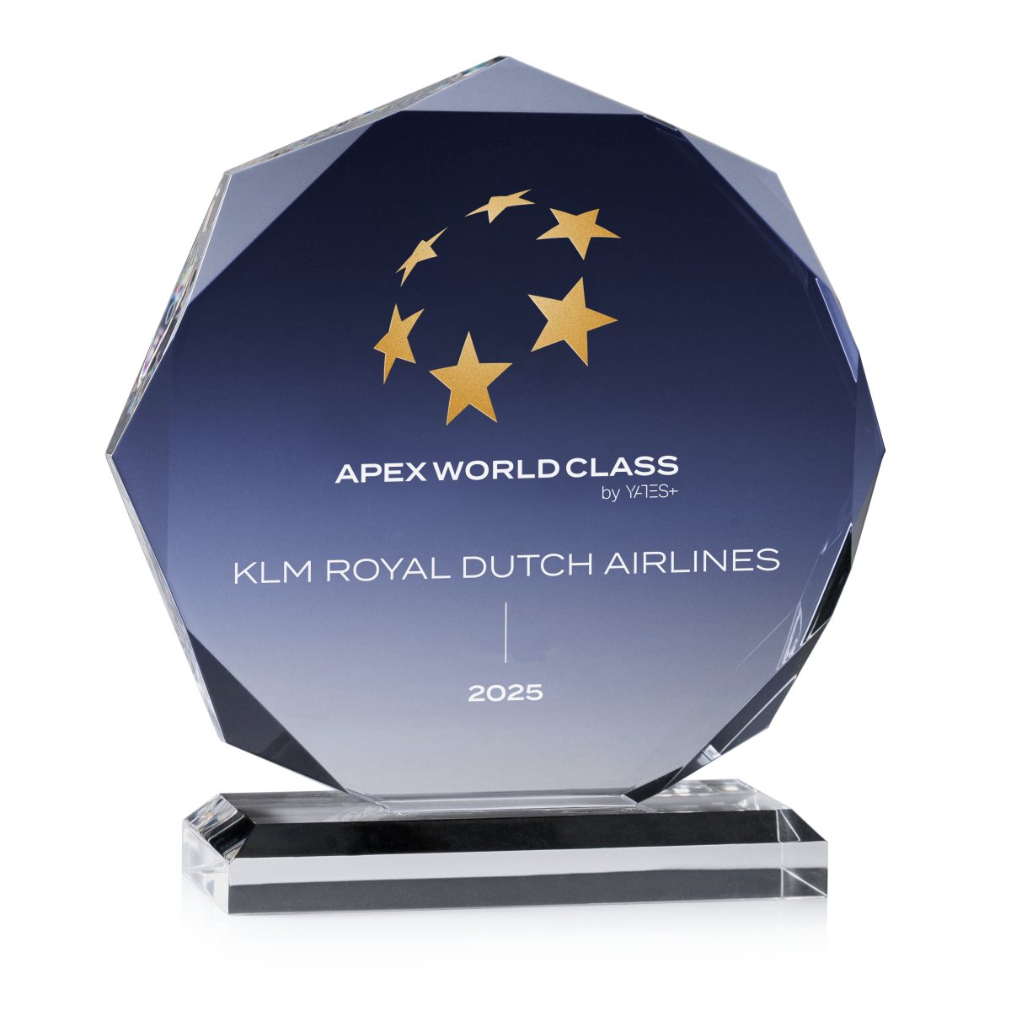
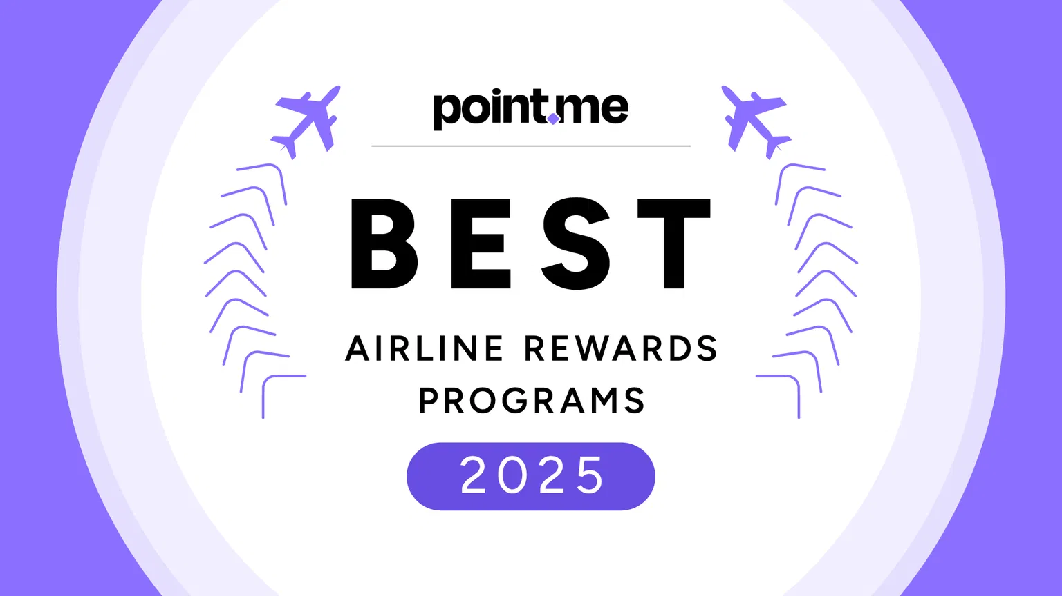
MAIN AWARDS

